Slide 1


Mobile Data Analysis (Exploratory Data Analysis)
Analyze Mobile data using exploratory data analysis techniques. Learn how to collect, preprocess, and visualize data.
Shaik Julfeen Ahmadh

Slide 2

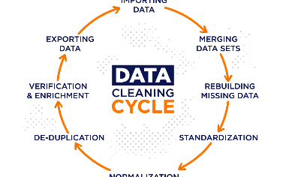
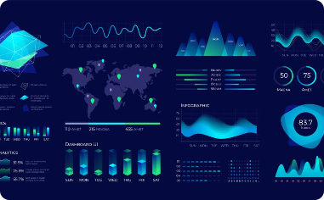
Exploratory Data Analysis
Data Collection
/Sourcing
Data Cleaning and Preprocessing
Data Visualization
Publicly accessible data is obtainable from diverse mobile sources, including sensors, logs, and surveys. This data is accessible through platforms like Kaggle.
Discover how to identify and Fixing the Rows and Columns, Impute/Remove Missing Values, Handling Outliers, Standardising Values, Fixing Invalid data and Filtering Data and Prepare data for analysis.
Explore different visualization techniques that allow you to communicate complex insights and patterns in mobile data.

Slide 3
Exploratory Data Analysis Techniques
Summary Statistics
Data Visualization Techniques
Understand the basic measures that summarize key aspects of mobile data distributions, such as central tendency and variability.
Explore how scatter plots, box plots, and histograms reveal different aspects of mobile data patterns and relationships
Correlation Analysis
Outlier Detection
Learn how to analyze the strength and direction of relationships between mobile data variables using correlation matrices, heatmaps, or scatter plots.
Identify extreme mobile data values using statistical tests or data visualization. Understand how outliers can distort data analyses and conclusions.

Slide 4
Standardising Values
Fixing Invalid data and Filtering Data
DATA CLEANING
1
Fixing the Rows and Columns
Impute/Remove Missing Values
2
3
Handling Outliers
4
5

Slide 5
6
Univariate Analysis
Categorical Unordered Univariate
Analysis
Categorical Ordered Univariate Analysis
Statistics on Numerical Features
Bivariate and Multivariate Analysis
7
Numerical-Numerical Analysis
Correlation vs Causation
Numerical-Categorical Analysis
Categorical - Categorical Analysis
8
Multivariate Analysis
Multivariate analysis examines datasets, analysing multiple variables simultaneously, often using tools like heat maps.

Slide 6
9
Distribution
Distribution in EDA analyses data patterns, revealing how values are spread. Histograms and statistical tests help understand data distribution.
Hypothesis Testing
Hypothesis testing assesses assumptions about data, comparing sample evidence to a null hypothesis to draw statistical inferences in research.
10

Slide 7
Benefits of Exploratory Data Analysis
1
Identifying Trends and Patterns
Uncover hidden trends and patterns in mobile data that can support informed decisions and innovation in mobile design and usage.
Uncovering Insights
2
Discover new insights and ideas about mobile user behavior, preferences, and needs that can address unmet needs or improve mobile services.
3
Making Data-driven Decisions
Support your decisions about mobile design, marketing, or policy by using evidence-based, reliable, and valid mobile data analyses and insights.

Slide 8
Price Distribution by Brand: There is significant variation in smartphone prices among different brands. Brands like Apple tend to have higher average prices compared to others.
Relationship Between Price and Rating: There is no clear linear relationship between the price and the rating of smartphones. Price alone does not determine the rating of a smartphone.
Operating System Impact on Ratings: There might be variations in ratings based on the operating system, as shown in the distribution by operating system
Internal Storage and Battery Capacity: Scatter plots indicate that there is no strong linear correlation between internal storage and battery capacity.
Brand Analysis: The dataset contains smartphones from various brands, and each brand has its own pricing
Insights

Slide 9

Conclusion
1
In All Segments Apple being a Premium brand Holds Its Monopoly around the globe and across every section from price to all specifications include rating.
2
The mobile industry is highly volatile, requiring substantial research and development to keep up and compete with other Brands

Slide 10
Thank you

